Slide 1

AUTOMATED CHESS PLAYING ROBOT USING COMPUTER VISION AND ROBOTIC ARM
Sec. and Group No. 09
Robotics Programming Workshop -2 (CSE 3197)
Under the supervision of: Dr. Shaktijeet Mohapatra,
Dr. Bhanja Kishor Swain
Assistant Professor, CIOT
Ashutosh Upadhyaya (2341021004)
Satyajit Panda(2341016091)
Satya Swarup Nayak (2341014076)
Arpan Senapati (2341019375)
Shashwat Mahapatra(2341013022)
Pratik Lauria (2341012006)
Shruti Sahoo (2341019153 )
Centre for IoT, ITER, Siksha ‘O’ Anusandhan (Deemed to be University), Bhubaneswar

Slide 2
Contents
Content | PageNo.
Aim | 3
Introduction | 4
Literature survey | 5
Motivation Behind Our Project | 6
Project objectives | 7
Block diagrams | 8
Circuit diagram | 9
Components | 10-11
Model Implementation & Code | 12-17
Results, Analysis and Evaluation | 18
Problem faced | 19
Areas of improvement | 20
Future opportunity | 21
Engineering tools and standards | 22
Project status | 23
References | 24
Conclusion | 25

Slide 3
Aim
The aim of this project is to design and develop an Automated Chess Playing Robot using a robotic arm, Raspberry Pi 5, computer vision, and artificial intelligence. The robot is capable of detecting chess moves, analyzing the chessboard using a chess engine, and physically moving chess pieces automatically on the board.
The project aims to demonstrate the practical implementation of:
Robotics and Automation
Embedded Systems
AI-based decision making
Human-machine interaction
Intelligent control systems
make it in form of bullet points

Slide 4
Introduction
The Automated Chess Playing Robot is an intelligent robotic system designed to play chess autonomously using a robotic arm, Raspberry Pi 5, computer vision, and artificial intelligence.
The system is capable of detecting chess moves, analyzing the game using Stockfish, and physically moving chess pieces on the board without human assistance.
This project combines the concepts of robotics, embedded systems, automation, and AI to create a smart and interactive system

Slide 5
Literature survey
Existing systems used Arduino and Raspberry Pi for robotic control.
Some projects implemented OpenCV for chessboard detection.
AI engines like Stockfish were used for move prediction.
Previous designs focused mainly on robotic movement or vision separately.
Our project combines computer vision, AI decision-making, and robotic automation together.

Slide 6
Motivation Behind Our Project
To combine robotics and artificial intelligence in a practical application.
To explore automation in strategic board games.
To develop a low-cost educational robotics system.
To improve knowledge in embedded systems and AI integration.
To demonstrate real-world robotic automation concepts.

Slide 7
Project objectives
To develop an automated chess playing robot using a robotic arm and Raspberry Pi 5.
To detect and analyze chess moves using computer vision techniques.
To integrate Stockfish for intelligent move generation and decision making.
To automate the physical movement of chess pieces using robotic arm control.
To demonstrate the application of robotics, AI, and embedded systems in real-world automation.

Slide 8
Block diagrams
RASPBERRY PI 5:
• Image Processing
• Chess Detection
• AI / Stockfish • Move Calculation
INPUT:
USB camera for (Board Capture)
CONTROL SIGNALS:
16 Channel servo driver
Gives command to the servos of the arm
Waits for the opponent’s next move
ROBOTIC ARM (Pick & Place)
Moves Chess Piece
Arm returns to base position

Slide 9
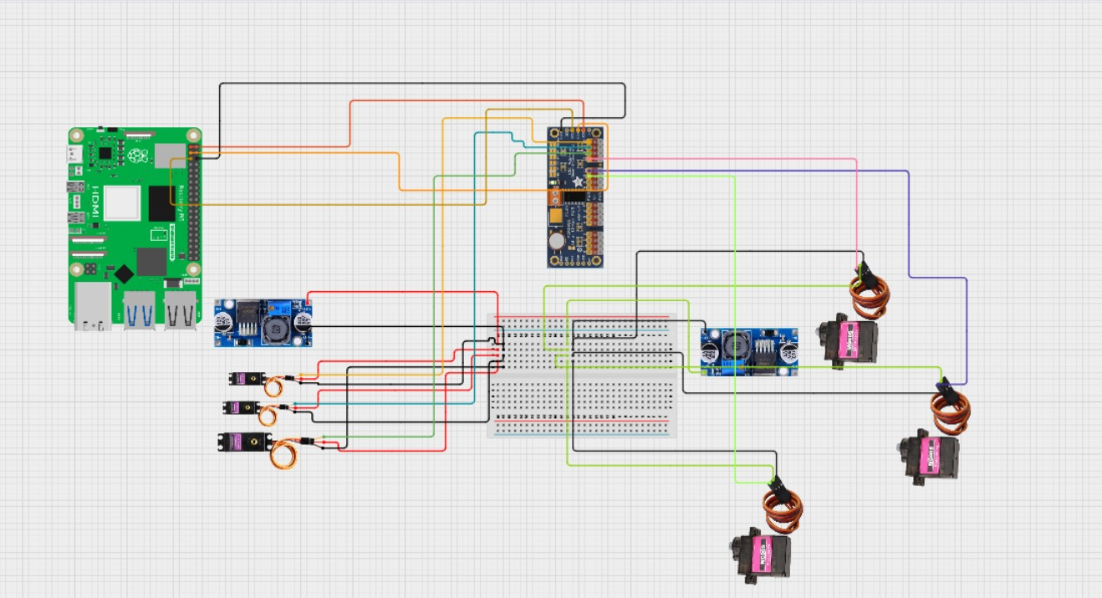
Circuit diagram

Slide 10
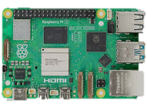
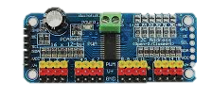
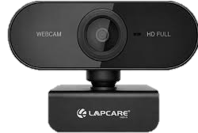
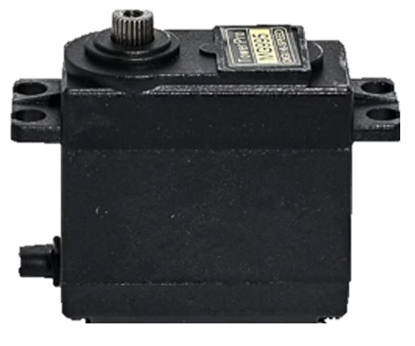
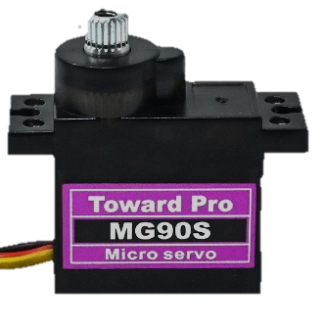
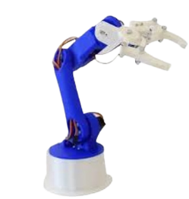
Components
Processing & Control Components | Images | Quantity
Raspberry Pi 5(2Gb) |  | 1
PCA9685 16-Channel Servo Driver |  | 1
USB Webcam |  | 1
MG995 Servo Motor & MG90S Metal Gear Servo |  | 3 each
Robotic arm |  | 1

Slide 11
Power Supply Components | Quantity
18650 Li-ion Battery Pack | 8
Buck Converter | 2
Power Switch | 1
Other Components | Quantity
Standard Chessboard | 1
Jumper Wires | Multiple
Flat 2.5x2.5 base | 1
Breadboard | 1

Slide 12
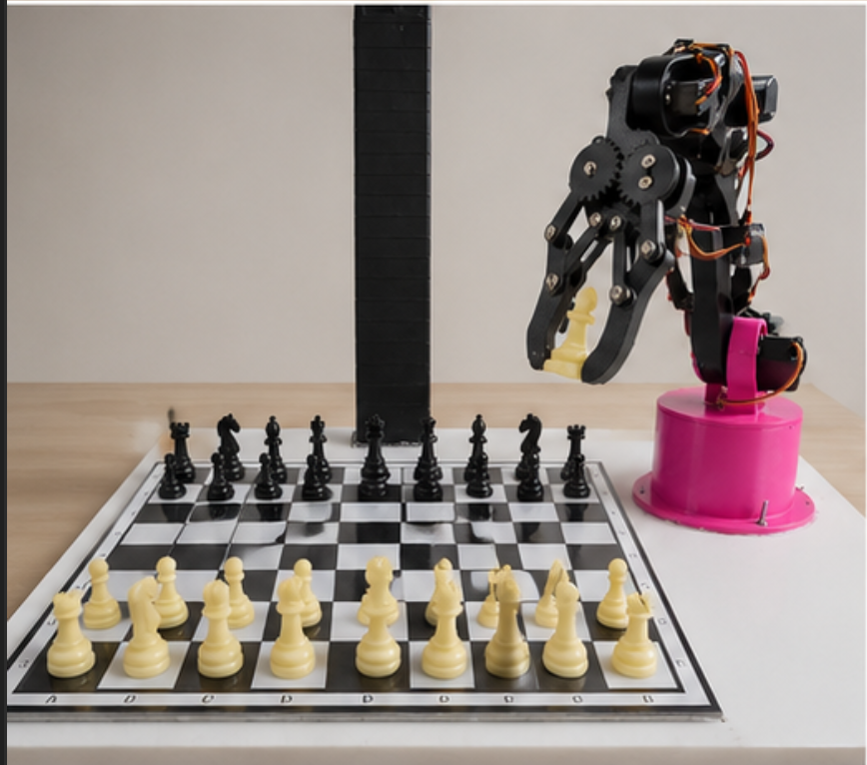
Model Implementation

Slide 13
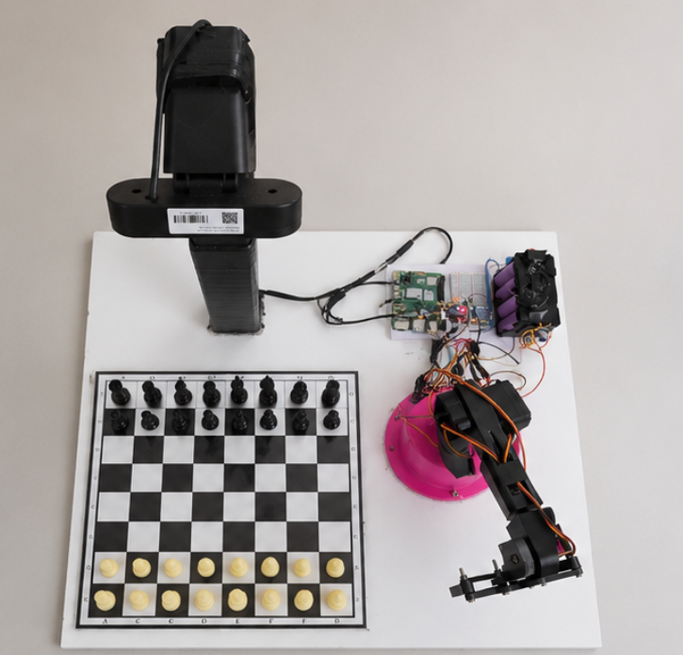
camera
Raspberry pi
Battery unit
Motor driver
Robotic arm

Slide 14
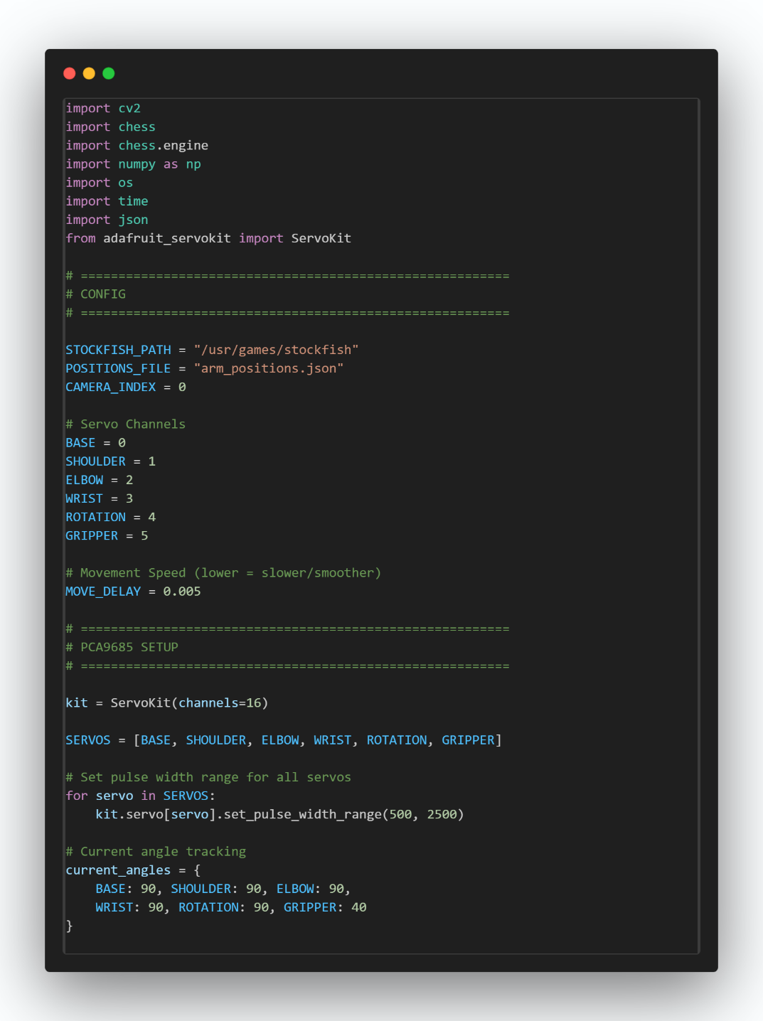
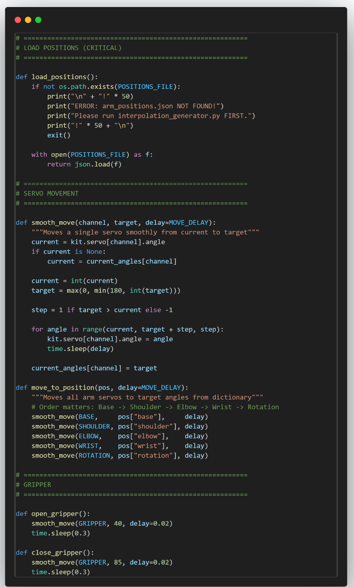
Code Implementation

Slide 15
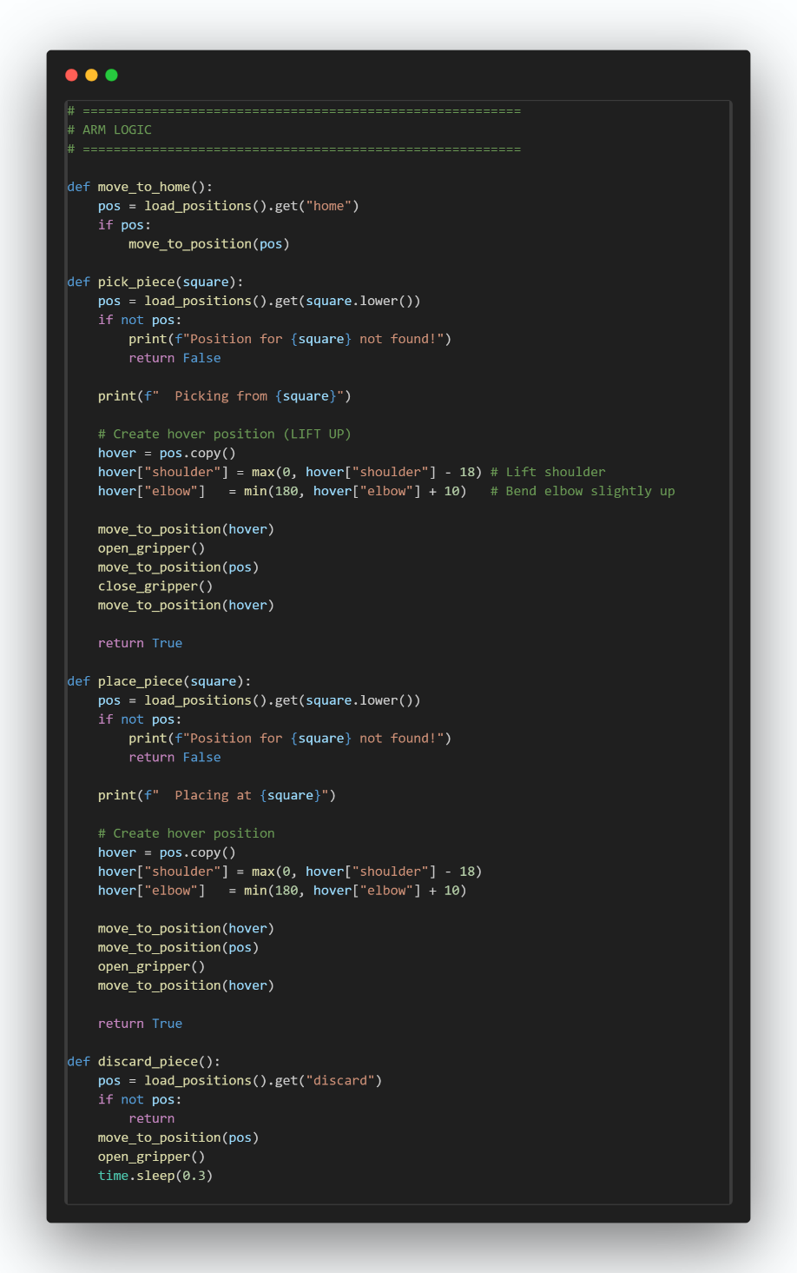
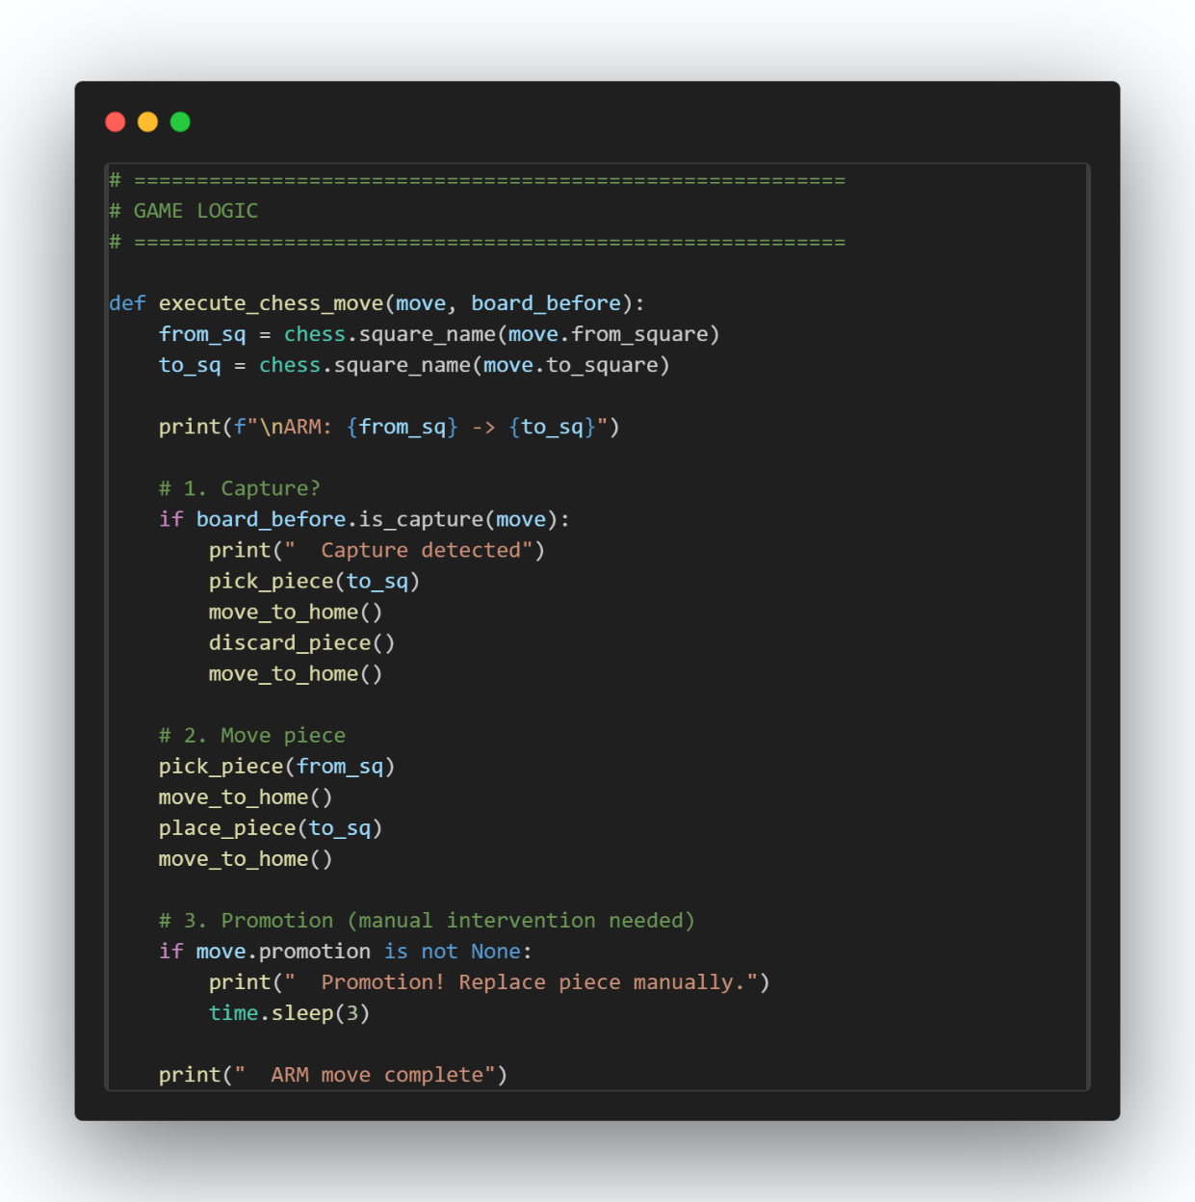

Slide 16
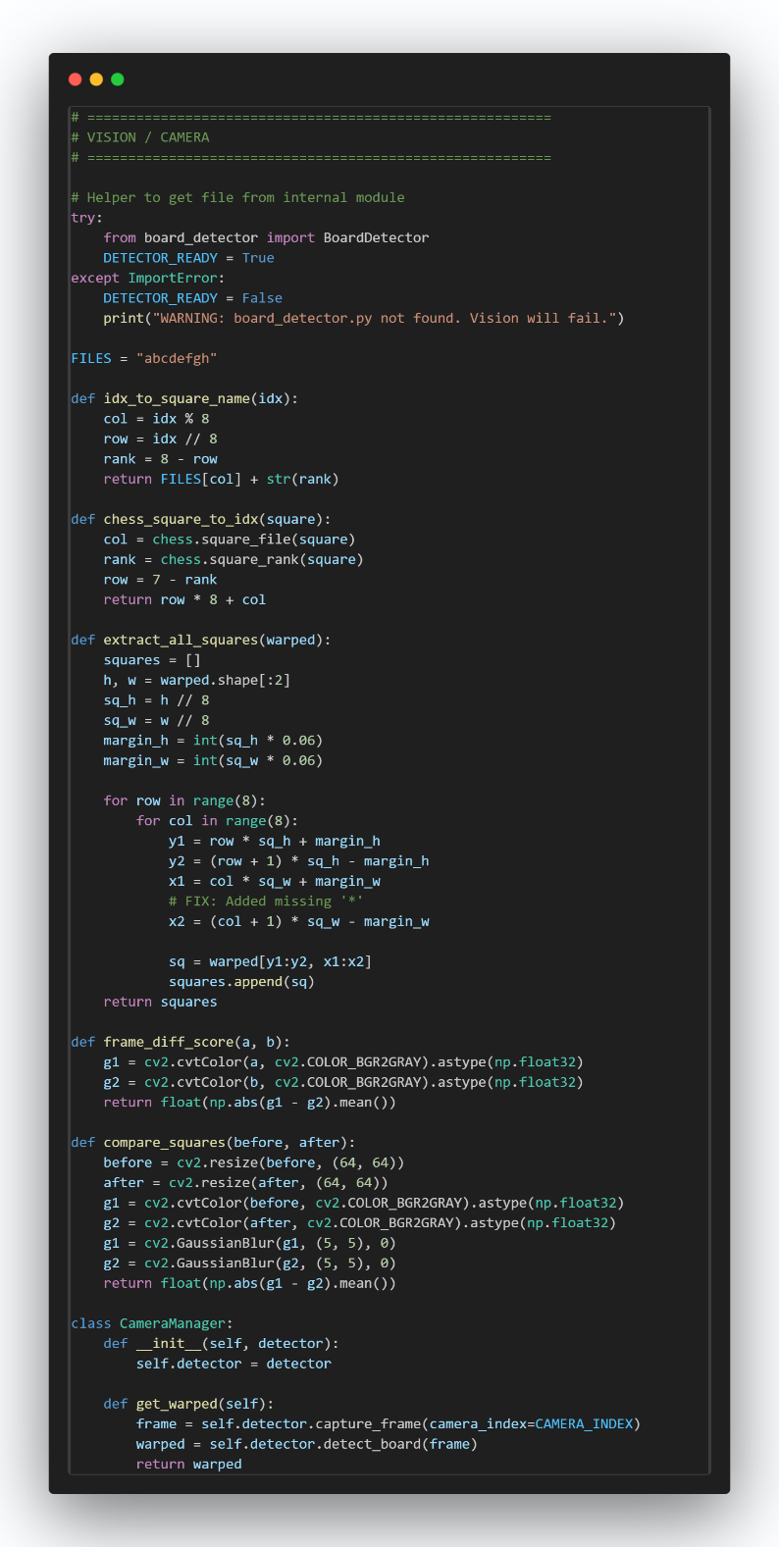
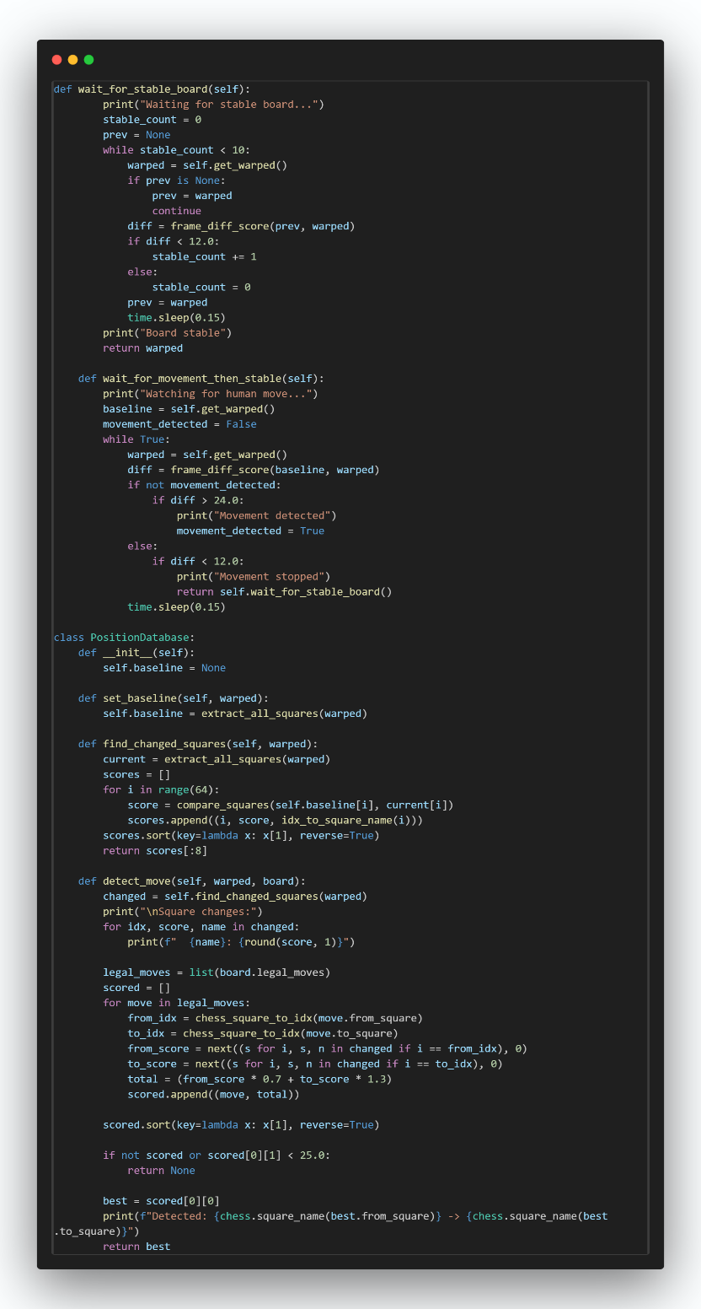

Slide 17
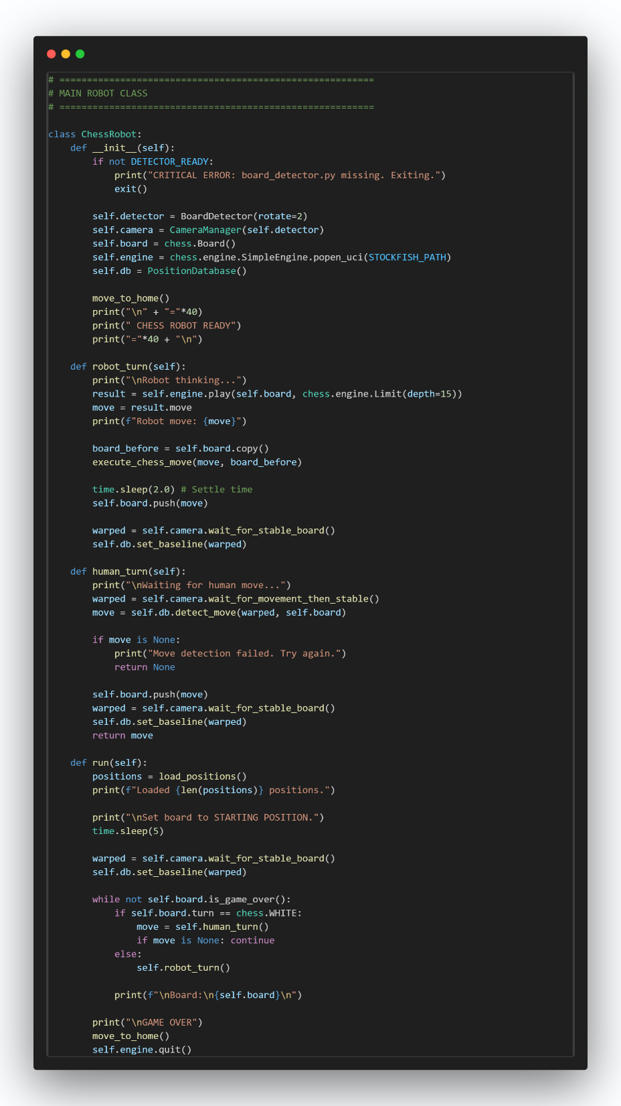
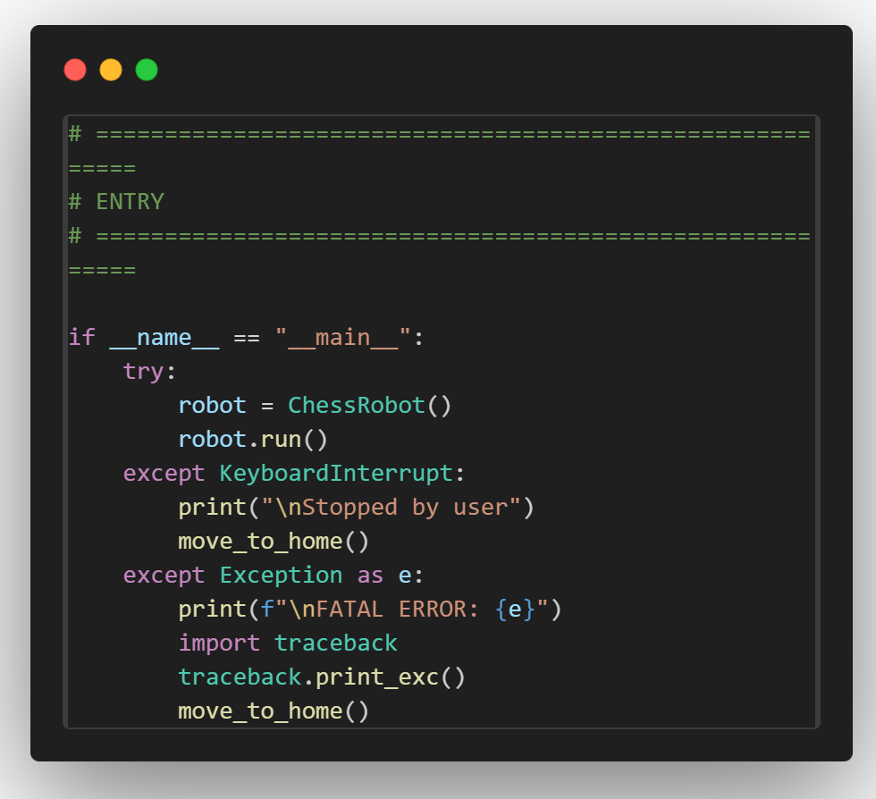

Slide 18
Results, Analysis and Evaluation
Results:
Successfully detected chessboard positions.
AI generated valid chess moves.
Robotic arm performed automated piece movement.
System demonstrated synchronized hardware and software operation.
Analysis:
OpenCV detection accuracy depends on lighting conditions.
Servo calibration improves movement precision.
Raspberry Pi handled image processing efficiently.
Evaluation:
Suitable for robotics learning and automation research.
Can be improved with advanced motion planning and voice interaction.

Slide 19
Problem Faced
Accurate piece detection
Reliable gripping of different chess pieces
Fast movement without knocking pieces over
Capturing and castling mechanics
Battery and power management
Real-time synchronization between vision, Stockfish, and robotic arm

Slide 20
Areas of improvement
Better Motion Control
Stepper motors with encoders
Precision gripping mechanisms
Collision avoidance
Autonomous Piece Recognition
Use deep learning models to recognize
Piece type
Board coordinates
Piece orientation
Natural Language Interface
Speech recognition
Text-to-speech
Conversational coaching

Slide 21
Future opportunities
1. Advanced Human-Robot Interaction
2. AI-Based Coaching System
3. Computer Vision Integration
4. Industrial Robotics Learning Platform
5. Smart Tournament Assistant
6. Research Opportunities

Slide 22
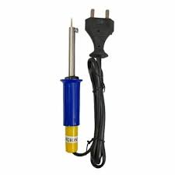
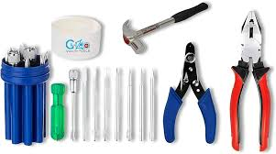
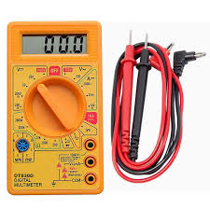
Engineering Tools and Standards
Tools as wire cutter , pliers,screwdriver etc
Soldering iron
multimeter

Slide 23
Project Status
Task | Status
Objective | ✓
Conceptualisation | ✓
Component Selection | ✓
Hardware Testing & Calibration | ✓
Hardware Implementation & Verifications | ✓
Software Implementation | ✓
Optimization | ✓
Final Packaging | ✓
Presentation & Report | ✓
Project Demonstration & Presentation

Slide 24
References
Autonomous Chess-Playing Robotic Arm using Raspberry Pi
An Open-Source Reproducible Chess Robot for Human-Robot Interaction Research
Chess Playing Robot Thesis (2020)
Design and Construction of a Cost-Effective Didactic Robotic Arm for Playing Chess
Chess Playing Robotic Arm Using Stockfish
Raspberry Turk: Chess Playing Robot
Chess Robot using Raspberry Pi and Lynxmotion Arm
Design and Implementation of an Autonomous Chess-Playing Manipulator
Playing Robot System Using Computer Vision and Stockfish

Slide 25
Conclusion
The Automated Chess Playing Robot successfully integrates AI, robotics, and embedded systems.
The system can detect chess moves, analyze the board, and physically move pieces automatically.
Demonstrates practical implementation of intelligent robotic automation.
Future scope includes voice interaction, better robotic precision, and advanced AI features.

